Slide 1

CSE – 2003 Project
Bhavya Goel
19BCE0378

Slide 2

Epidemic Confinement using Convex Hull
To find minimum possible danger area from which we need to evacuate people with the help of CONVEX HULL.

Slide 3

Algorithms Used
Jarvis March Algorithm
Graham Scan Algorithm

Slide 4

KEY FEATURES
Marking the area to be kept under strict surveillance, to prevent further outbreak
Graphical representation of the resulting area
Calculating the area to be kept under surveillance

Slide 5
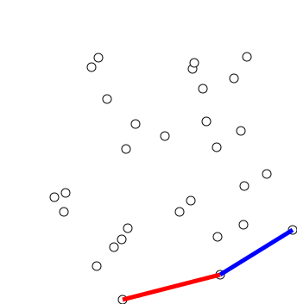
Graham Scan [O(nLogn)]
The idea of how points are oriented plays a key role in understanding graham’s algorithm.

Slide 6
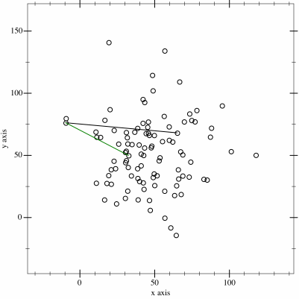
Jarvis March [O(n²)]
The idea or Jarvis March algorithm is that, we start from the leftmost point (or point with minimum x coordinate value) and we keep wrapping points in counterclockwise direction.

Slide 7
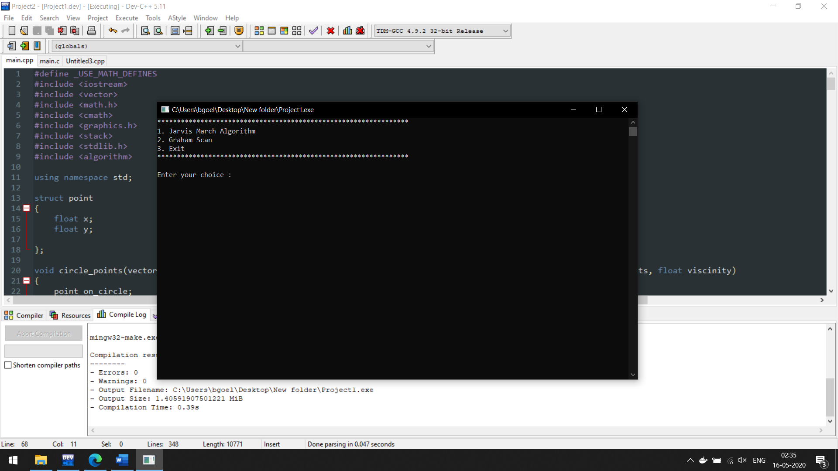
OUTPUT

Slide 8
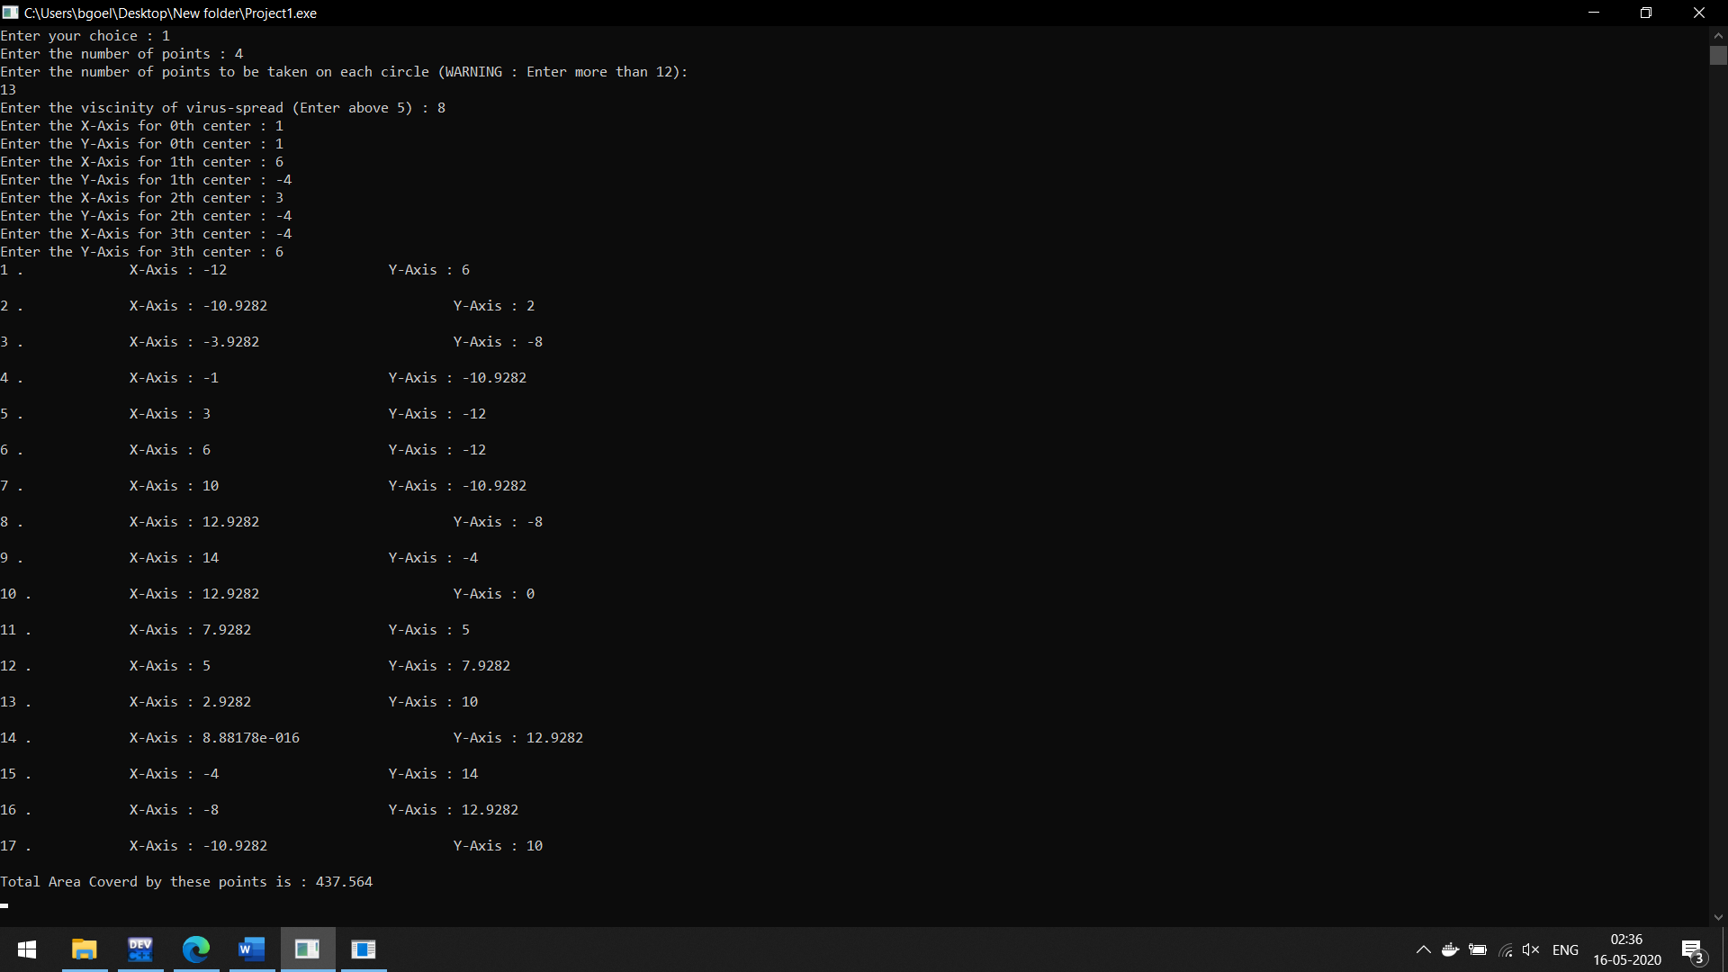
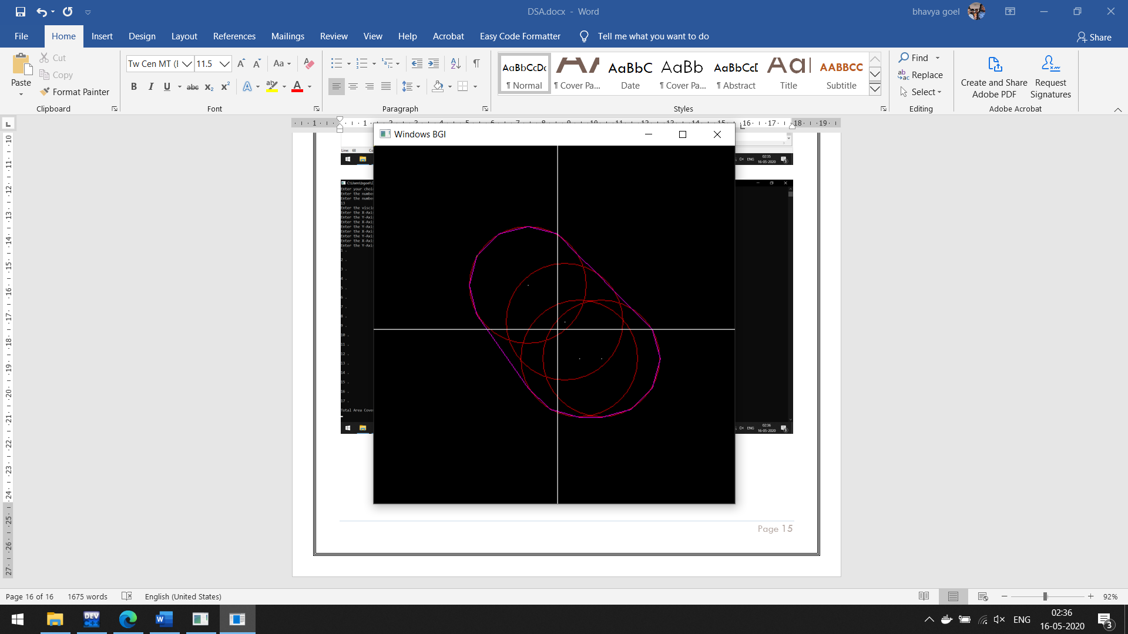
JARVIS MARCH

Slide 9
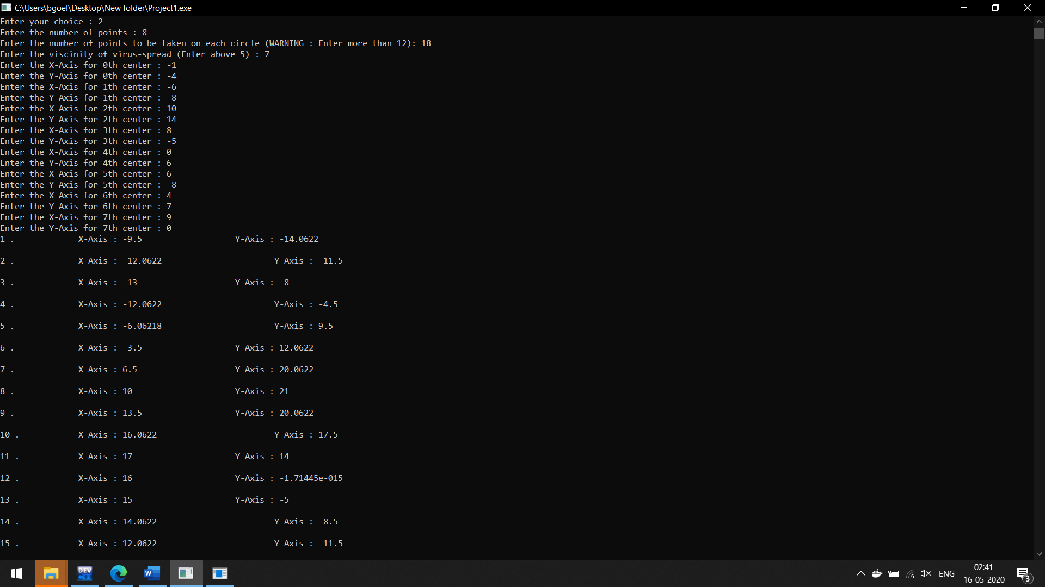
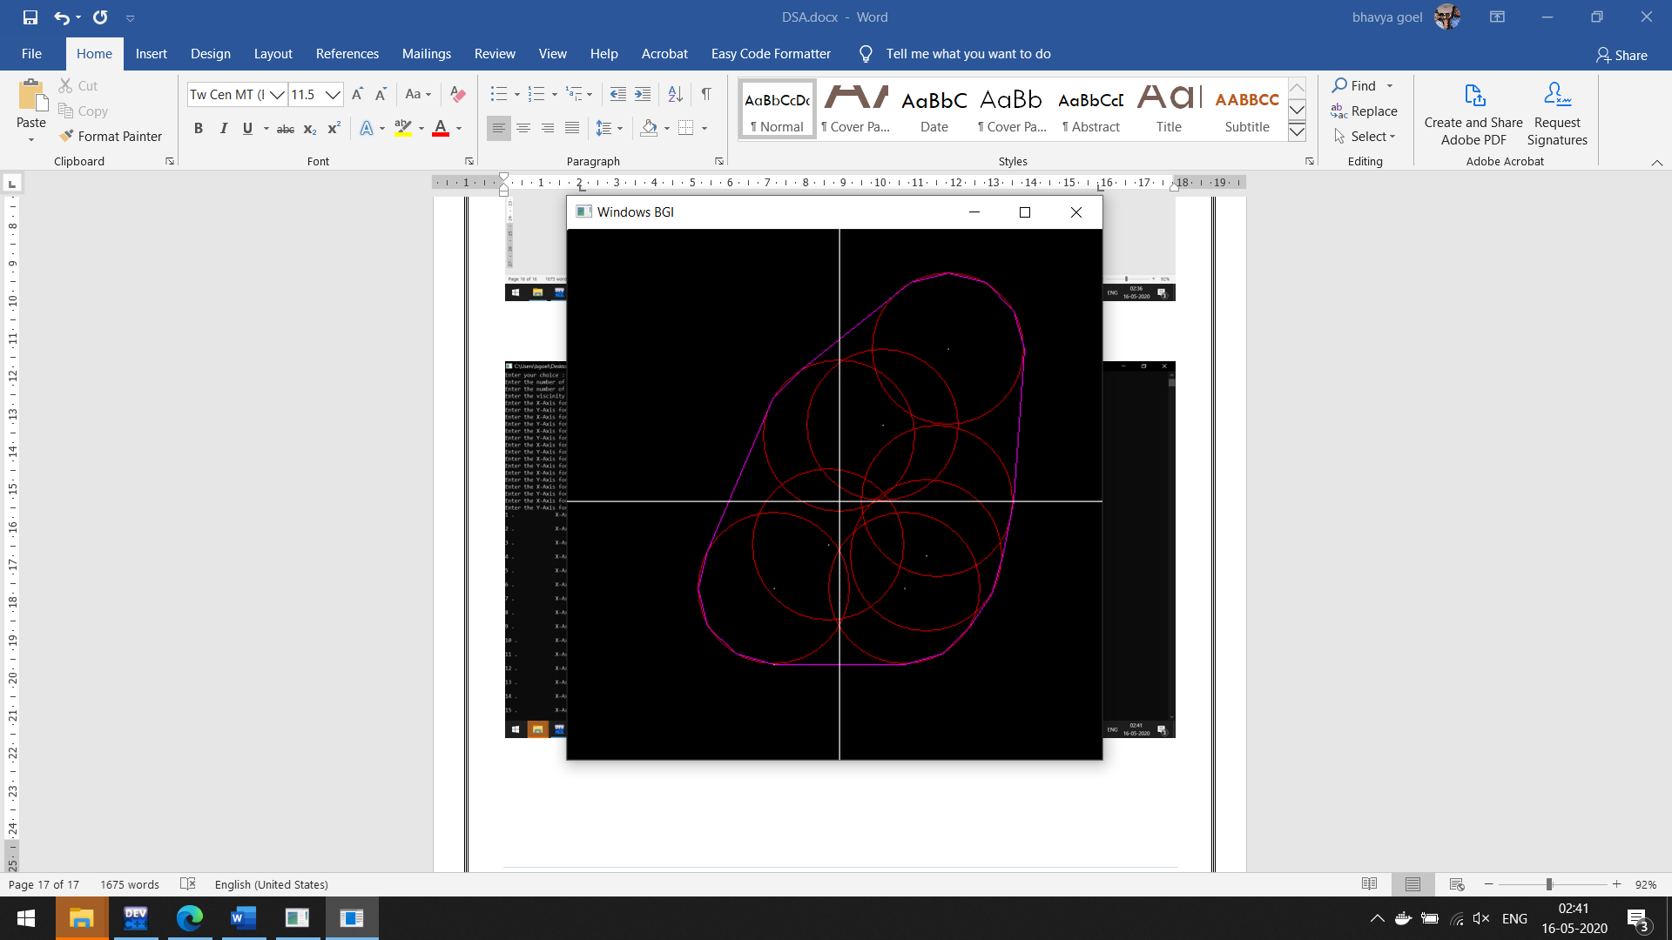
GRAHAM SCAN

Slide 10

Reference: https://web.ist.utl.pt/~fabio.ferreira/material/asa/clrs.pdf

Slide 11





Thank You
Bhavya Goel
+91 7042089702
Bhavya.goel2019@vitstudent.ac.in
https://codeshare.io/5zAnZ4

Slide 12
Customize this Template
Template Editing Instructions and Feedback

